Slide 1
PORPHYRIA
By: Dr. Jyoti Kumari
Assistant professor
Department of biochemistry

Slide 2
Porphyria
Porphyrias are the metabolic disorders of heme synthesis, characterized by the increased excretion of porphyrins or porphyrin precurcors.
• Porphyrias are either inherited or acquired.
• The most common acquired form of porphyria
is due to lead poisoning.

Slide 3
Classification of porphyrias
Porphyrias
Erythropoietic
Hepatic
Erythropoietic (bone marrow):
• Enzyme deficiency occurs in the erythrocytes.
Hepatic:
• Enzyme defect lies in the liver.

Slide 5
Hepatic porphyria
• Acute intermittent porphyria:
• Enzyme defect: Uroporphyrinogen I synthase
• Characteristic features:
• Increased excretion of porphobilinogen & γ-ALA.
• Urine gets darkened on exposure to air due to
conversion of porphobilinogen to porphobilin &
porphyrin.
• It usually expressed after puberty

Slide 6
Symptoms
Abdominal pain, vomiting & cardiovascular
abnormalities.
• Neuropsychiatric distrubances- due reduced
activity of tryptophan pyrrolase (caused by
depleted heme levels) resulting in the
accumulation of tryptophan & 5-
hydroxytryptamine.

Slide 7
Symptoms are more severe after
administration of drugs (e.g. barbiturates)
It induce the synthesis of cytochrome P450.
This is due to the increased activity of ALA
synthase causing accumulation of PBG & ALA.
These patients are not photosensitive.
It is treated by administration of hematin, it
inhibits ALA sytnthase & accumulation of
porphobilinogen.

Slide 8
Porphyria cutanea tarda
• This is also known as cutaneous hepatic
porphyria & is the most common porphyria.
• It associated with liver damage caused by
alcohol overconsumption or iron overload.
• Enzyme deficiency:
• Uroporphyrinogen decarboxylase.

Slide 9
Characteristic features
• lncreased excretion of uroporphyrins (l & lll) &
rarely porphobilinogen.
• Cutaneous photosensitivity is the most
important clinical manifestation of these patients.
• Skin fragility, scarring, sclerodermoid skin
changes.
• Liver exhibits fluorescence due to high
concentration of accumulated porphyrins.

Slide 10
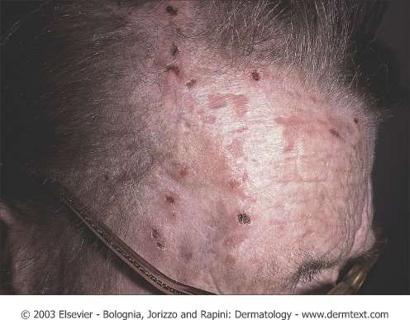
Porphyria cutanea tarda

Slide 11
Hereditary coproporphyria
• Enzyme defect:
• Coproporphyrinogen oxidase.
• Coproporphyrinogen lll & other intermediates
(ALA and PBC) of heme synthesis prior to the
blockade are excreted in urine & feces.
• The patients are photosensitive.

Slide 12
Symptoms
• Symptoms are similar to acute intermittent
porphyria
• Abdominal pain, vomiting & cardiovascular
abnormalities.

Slide 13
• Neuropsychiatric distrubances- due reduced
activity of tryptophan pyrrolase (caused by
depleted heme levels) resulting in the
accumulation of tryptophan & 5-
hydroxytryptamine.
• It is treated by administration of hematin, it
inhibits ALA stnthase & accumulation of
porphobilinogen.

Slide 14
Variegate porphyria
• Enzyme defect: Protoporphyrinogen oxidase.
• Due to this blockade, protoporphyrin lX required for
the ultimate synthesis of heme is not produced.
• Almost all the intermediates (porphobilinogen,
coproporphyrin, uroporphyrin, protoporphyrin etc.) of
heme synthesis accumulate in the body & are excreted
in urine and feces.
• The urine of these patients is coloured & they exhibit
Photosensitivity.

Slide 15
Erythropoietic porphyria
• Congenital erythropoietic porphyria:
• Enzyme defect:
• Uroporphyrinogen III cosynthase.
• Also caused by an imbalance between the
activities of uroporphyrinogen I synthase and
uroporphyrinogen lll cosynthase

Slide 16
Characteristic features
• It is a rare congenital disorder.
• Mostly contained in erythropoietic tissues
(bone).
• Individuals excrete uroporphyrinogen I &
coproporphyrinogen I which oxidize
respectively to uroporphyrin I & coproporphyrin I.

Slide 17
• The patients are photosensitive (itching &
burning of skin when exposed to light).
• Skin pain or burning in sunlight
• Erythema, swelling.
• Erosions in light exposed areas-mainly in
face & hands.
• Scarring - shallow circular or linear.
• Waxy thickening of the skin.
• Increased hemolysis.

Slide 18
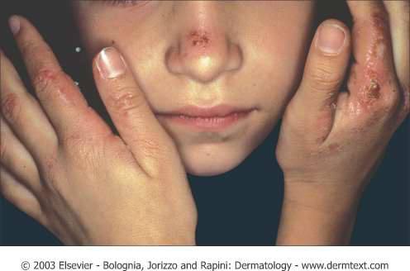
Erythropoietic porphyria

Slide 19
Protoporphyria
• Also known as erythropoietic protoporphyria.
• Enzyme defect:Ferrochelatase.
• Protoporphyrin IX accumulates in tissues & is
excreted into urine & feces.
• Reticulocytes (young RBC) & skin biopsy exhibit red flourorescence.

Slide 20
Acquired or toxic porphyria
• It occur due to toxicity of several compounds.
• Exposure of the body to heavy metals (e.g.
lead), toxic compounds (hexachlorobenzene)
and drugs (e.g. griseofulvin) inhibits many
enzymes in heme synthesis.
• These includes ALA dehydratase, uroporphyrin I synthase & ferrochelatase.

Slide 22
Thank You

